Slide 1
Course Overview

Slide 2


Slide 3
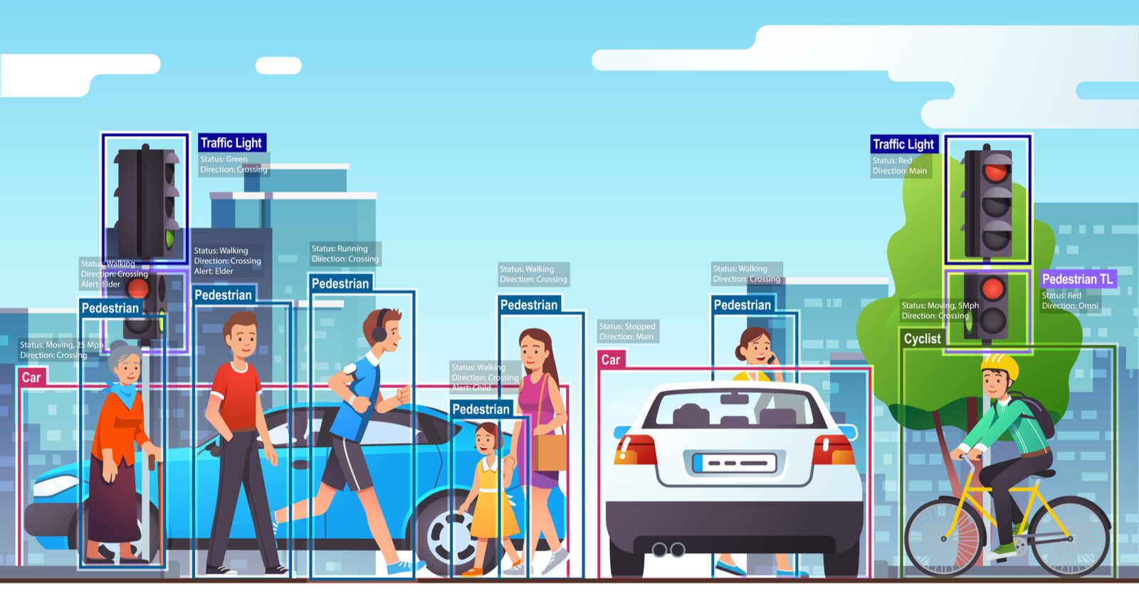

Slide 4
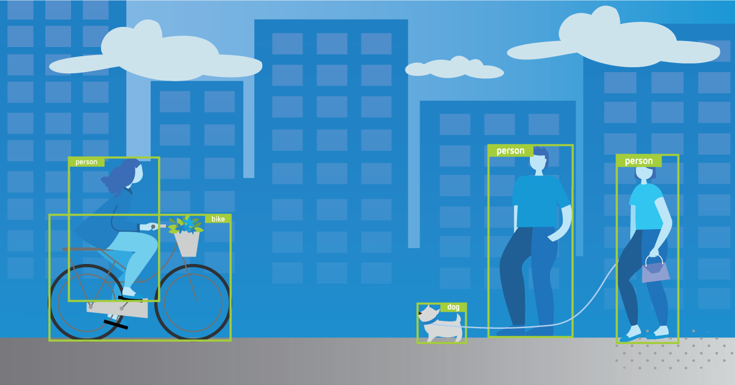

Slide 5
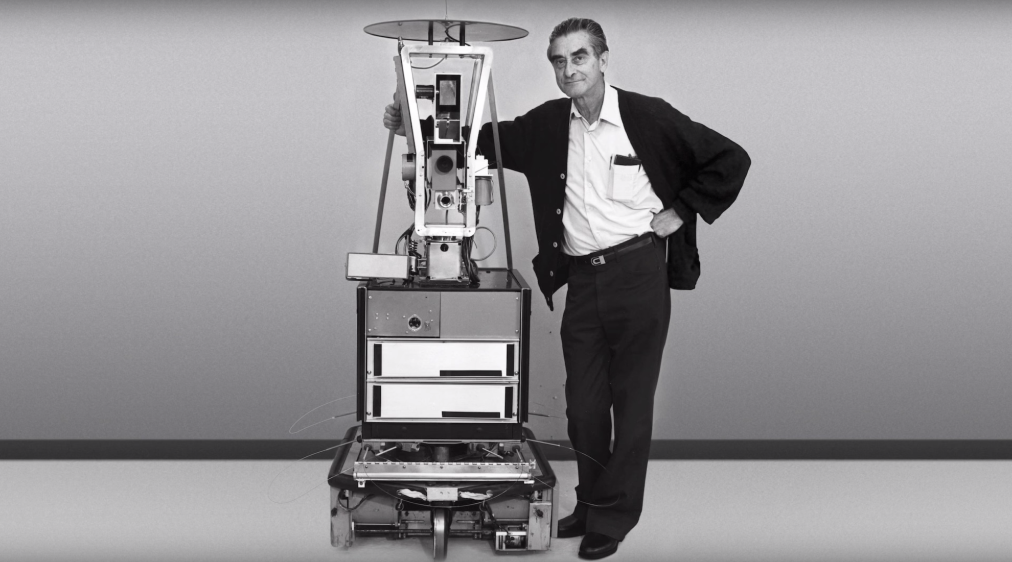

Slide 6
Video footage of Shakey
https://youtu.be/GmU7SimFkpU?t=887

Slide 7
Pictures of A* search
https://www.redblobgames.com/pathfinding/a-star/introduction.html

Slide 8
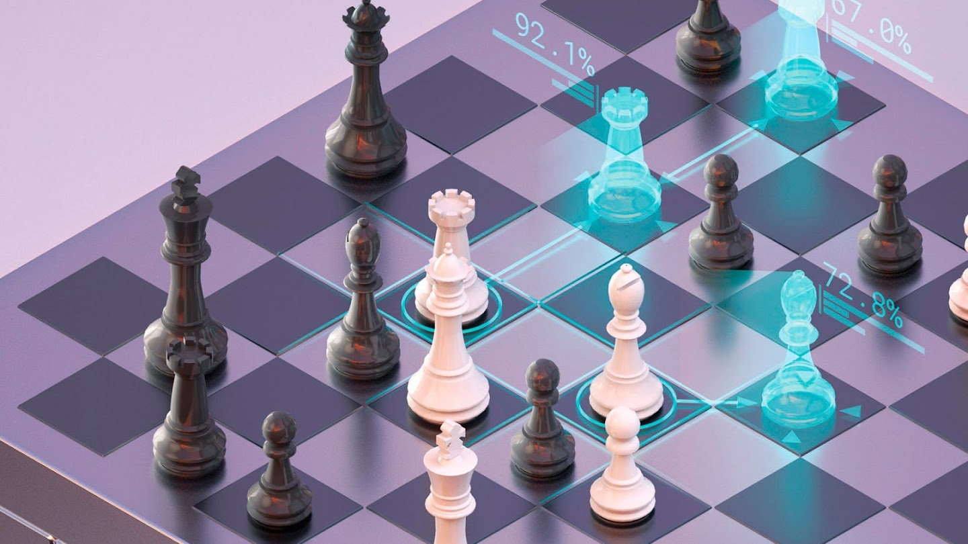
https://deepmind.com/research/case-studies/alphago-the-story-so-far

Slide 9
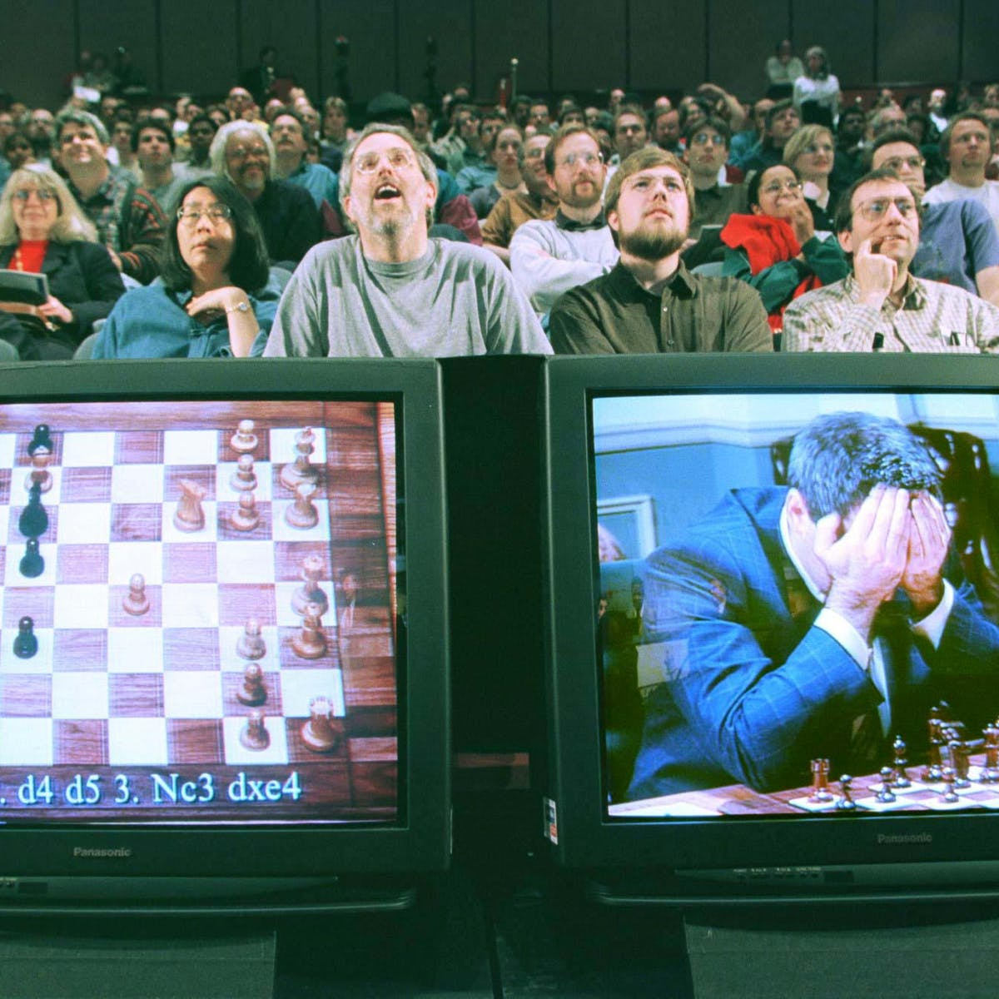

Slide 10
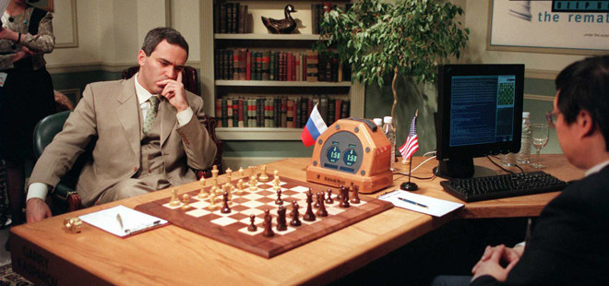

Slide 11
Games: Chess
https://www.youtube.com/watch?v=KF6sLCeBj0s

Slide 12
Games: Go
https://www.youtube.com/watch?v=8tq1C8spV_g

Slide 13

Probability

Slide 14


Slide 15


Slide 16
Reinforcement learning
https://openai.com/blog/emergent-tool-use/
https://openai.com/blog/competitive-self-play/
https://youtu.be/hx_bgoTF7bs?t=11

Slide 17

Natural language processing

Slide 18
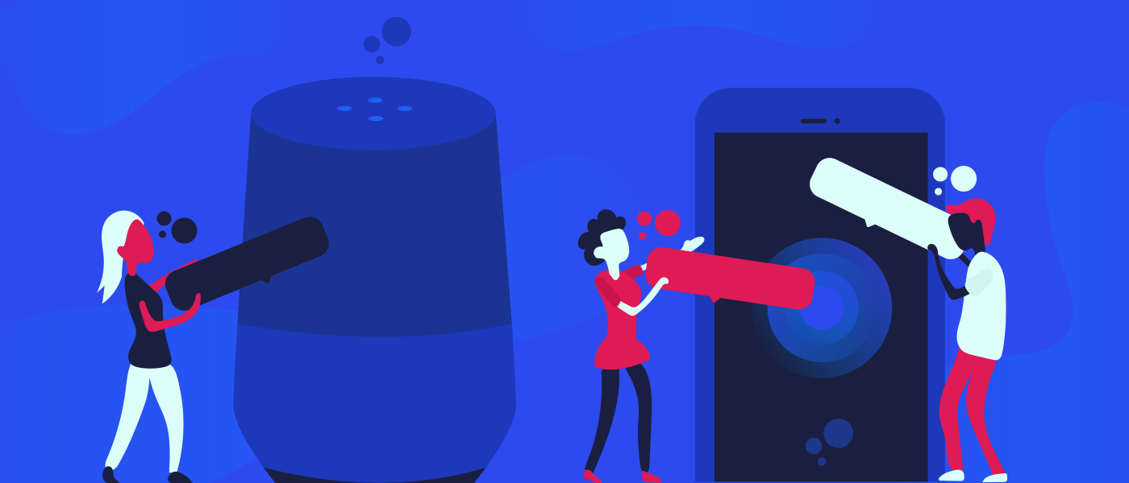

Slide 19


Slide 20


